Slide 1
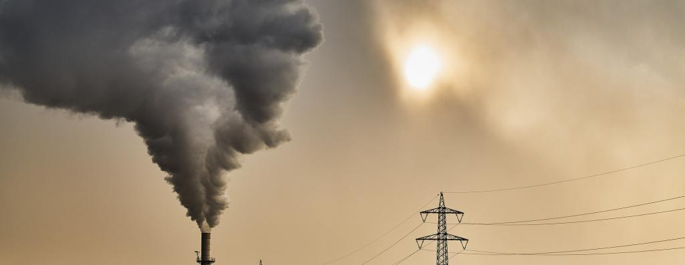
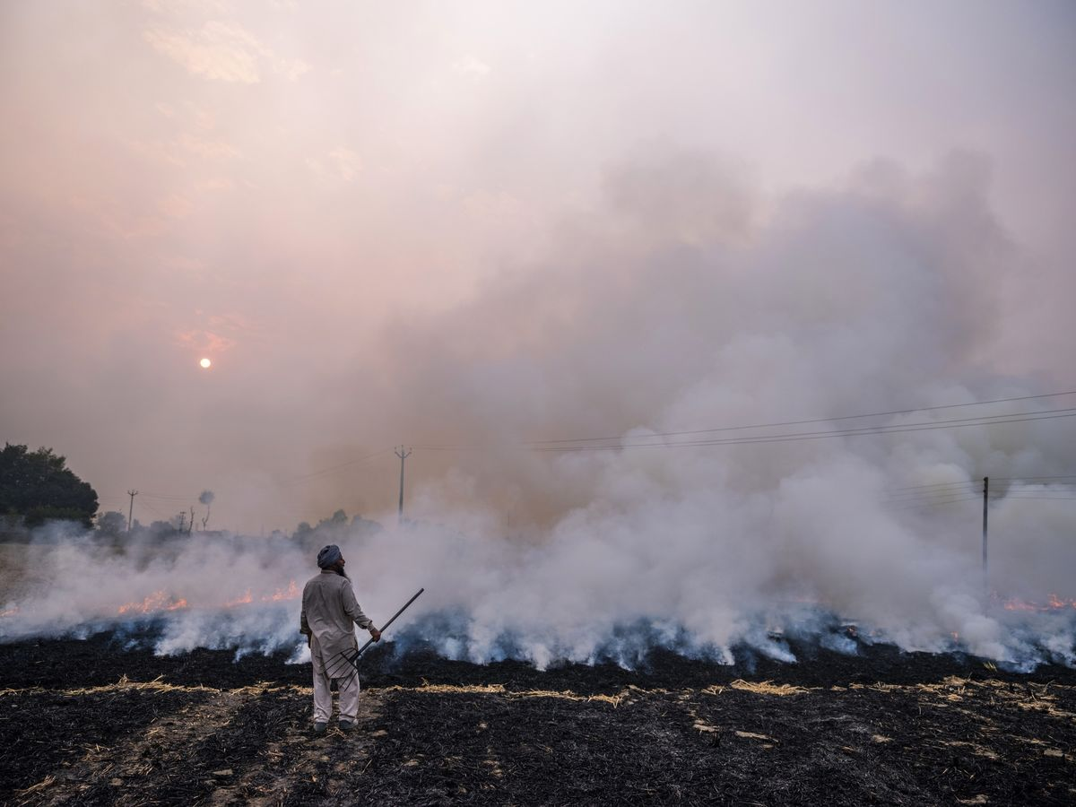
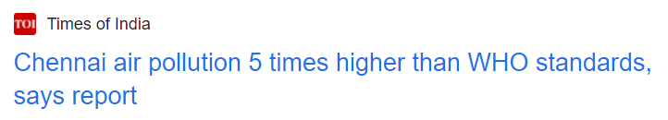
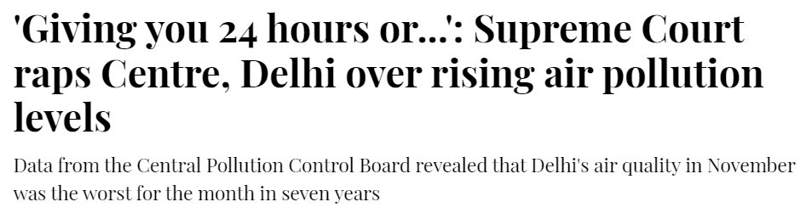
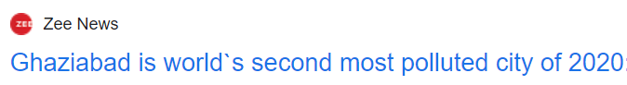
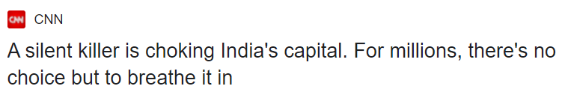
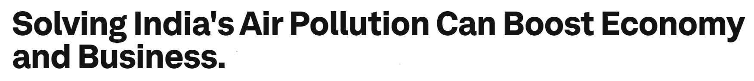
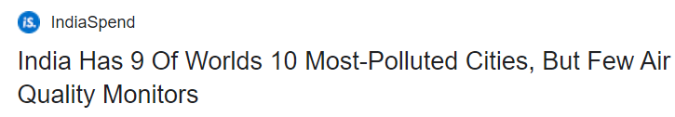
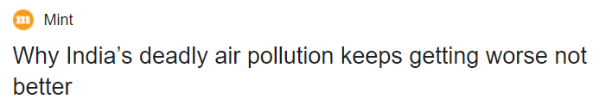
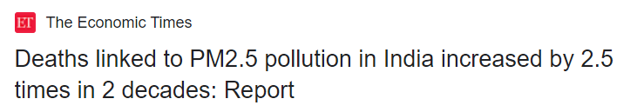
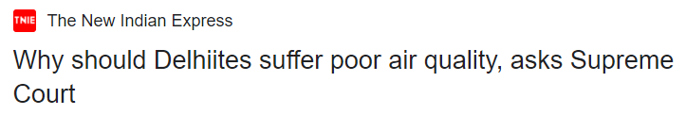
Dr. AQI
For a Healthier life that we deserve!

Slide 2

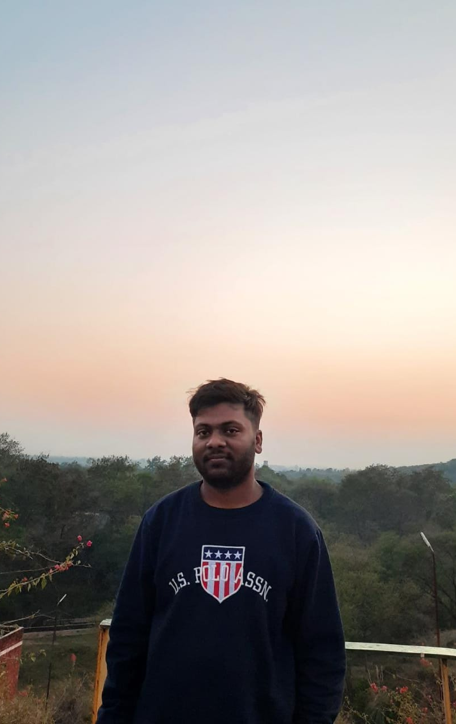
Meet Our
SAUJANYA RAJ
CHANDAN KUMAR

Slide 3

01
01
PROBLEM STATEMENT

Slide 4
Alarming level of Air Pollution in India
Twenty-two of the world’s 30 cities with the worst levels of air pollution are in India; six Indian cities are in the top ten. (IQAir AirVisual’s 2019 World Air Quality Report)
At least 140 million people in India breathe air that is 10 times or more over the WHO safe limit of 60 for PM 2.5.(based on 2016 data)
All of India’s 1.4 billion people (100% of the country’s population) are exposed to unhealthy levels of ambient PM 2.5 – the most harmful pollutant.
1.7 million deaths in India were attributable to air pollution in 2019, which was 18% of the total deaths in the country according to India State-Level Disease Burden Initiative, a scientific paper on the health and economic impact of air pollution published last December in Lancet Planetary Health.
Deaths Tied to Air Pollution Tripled in The Past 20 Years in India
Air pollution is India’s second-largest public health risk after malnutrition
Air pollution may reduce life expectancy of Indians by nine years.

Slide 5
2) Lack of proper mitigation strategy & unified approach. Interference by different agencies such as Supreme Court of India, National Green Tribunal (NGT), Ministries.
India's Air Pollution Mitigation Strategy lacks proper Direction. Mostly metro cities have certain mitigation measures well-defined however there’s lack of such measures in many states.
There’s a lack of unified approach by state govt. And central govt. And respective concerned authorities which leads to delay in implementation of various mitigation measures and subsequent loss to exchequer.
Many times, the courts have had to intervene for the authorities to take action on air pollution which are done in a haste or for the sake of compliance.
3) Failure of existing Graded Response Action Plan (GRAP): Non-availability of varied real time data from limited number of air pollution monitoring stations
In 2016, the Supreme Court approved the implementation of a Graded Response Action Plan (GRAP). Pursuant to this, the government notified the GRAP to be implemented through the Environment Pollution (Prevention & Control) Authority (EPCA). GRAP is basically a plan to be implemented when the air quality deteriorates.

Slide 6

Under the National Air Quality Monitoring Programme (NAMP),There are 573 operating stations in only 240 cities/towns (out of 4000 cities in India) in 26 states (out of 28 states in India) and 5 Union Territories (out of 8 Union Territories in India) of the country.
Let’s take case of Bihar. The state capital Patna and Muzaffarpur figured among the four most polluted cities in the country and among the 32 most polluted cities globally, according to the the ‘World Air Quality Report, 2020’.
Now according to National Air Quality Monitoring Programme (NAMP), there are only 2 Air quality monitoring stations in Bihar that too only in Patna.

Slide 7
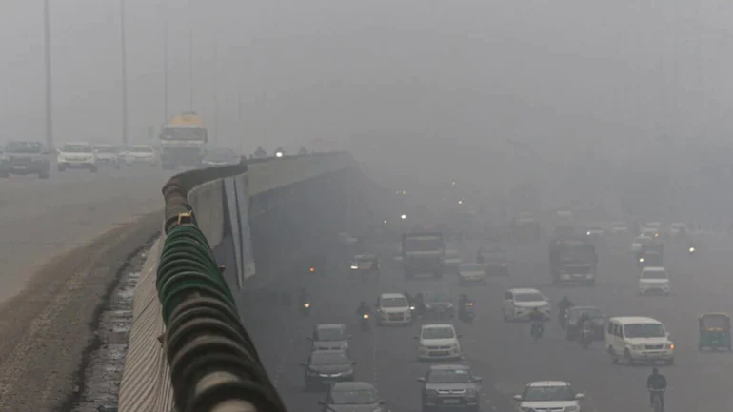
IDEA/ SOLUTION
02
02

Slide 8

Dr. AQI app is a first-of its kind app combining both
Real-Time AQI monitoring and mitigation strategy for implementation as per severity of AQI level
A.) MONITORING
Real-Time AQI Data will be pooled from Government Pollution Monitoring Stations, Private Pollution Monitoring Stations, various pollution check up centres and portable AQI monitors on Ola/Uber Taxis. It will be populated on the server master console.
The severity of AQI will get highlighted area-wise.
B.) MITIGATION
The historical data in conjugation with real-time data shall be processed using AI/ML and priority zoning will be done for an area covering 500 m radius. Proper mitigation measures will be suggested for implementation according to the AQI category of the zone.
The effectiveness of the measures shall be captured in the system in quantitative way and shall be further displayed on the App’s dashboard.
Example: Let’s take case of Delhi where the AQI index is Severe (497 AQI), our App will suggest the following Mitigation Measures.

Slide 9
Severe + or Emergency (ambient PM_{2.5} or PM₁₀ concentration values of 300μg/m³or 500 μg/m³ respectively persist for 48 hours or more) | Mitigation Strategy/Measures
Stop entry of truck traffic into Delhi (except essential commodities) | SMS Alert to Municipal Corporations and Traffic Police of Delhi and NCR Towns
Stop construction activities | SMS Alert to Delhi Pollution Control Committee/Municipal Corporations of Delhi and NCR towns
Activation of Quick Response Team (QRT) | Real-Time supervision using drone camera and fogging through drones and truck mounted foggers.
Task Force to take decision on any additional steps including shutting of schools | SMS Alert to School Directorate and Mayor

Slide 10
Severe (ambient PM_{2.5} or PM₁₀ concentration value is more than 250 μg/m³or 430μg/m³ respectively) | Mitigation Strategy/Measures
Close brick kilns, Hot Mix plants, Stone Crushers | SMS Alert to Chairpersons Delhi Pollution Control Committee & Superintendent of Police and Deputy Commissioner of respective districts
Shut down power plant and maximize generation of power from existing natural gas based plants to reduce operation of coal based power plants in the NCR. | SMS Alert to Chairpersons Delhi Pollution Control Committee
Increase frequency of mechanized cleaning of road and sprinkling of water on roads using Drones. | SMS alert to All road owning agencies including Municipal Corporations of NCT of Delhi and NCR towns, Public Works Departments and National Highway Authority of India

Slide 11
UNIQUENESS OF OUR PROJECT IDEA
03
03

Slide 12
Large number of Monitoring stations involving dynamic data (OLA/UBER).
Other Apps rely on Static Data which is less-reliable and inaccurate. Dr. AQI relies on dynamic data which is more accurate (Moving cars). Also revalidation of data can be done using AI/ML.
Real-Time Mitigation measures/SOPs to decrease alarming levels of pollution.
Feedback taken on effectiveness of mitigation measures can be utilised for improving the accuracy of suggestive mitigation measures and hence will lead to optimisation of resources.
QRT (Quick Response Team) concept provides a new dimension to our app.
Area-wise and time-wise proper planning can be done in most polluted cities of India through our App

Slide 13
APP UI
04
04

Slide 14
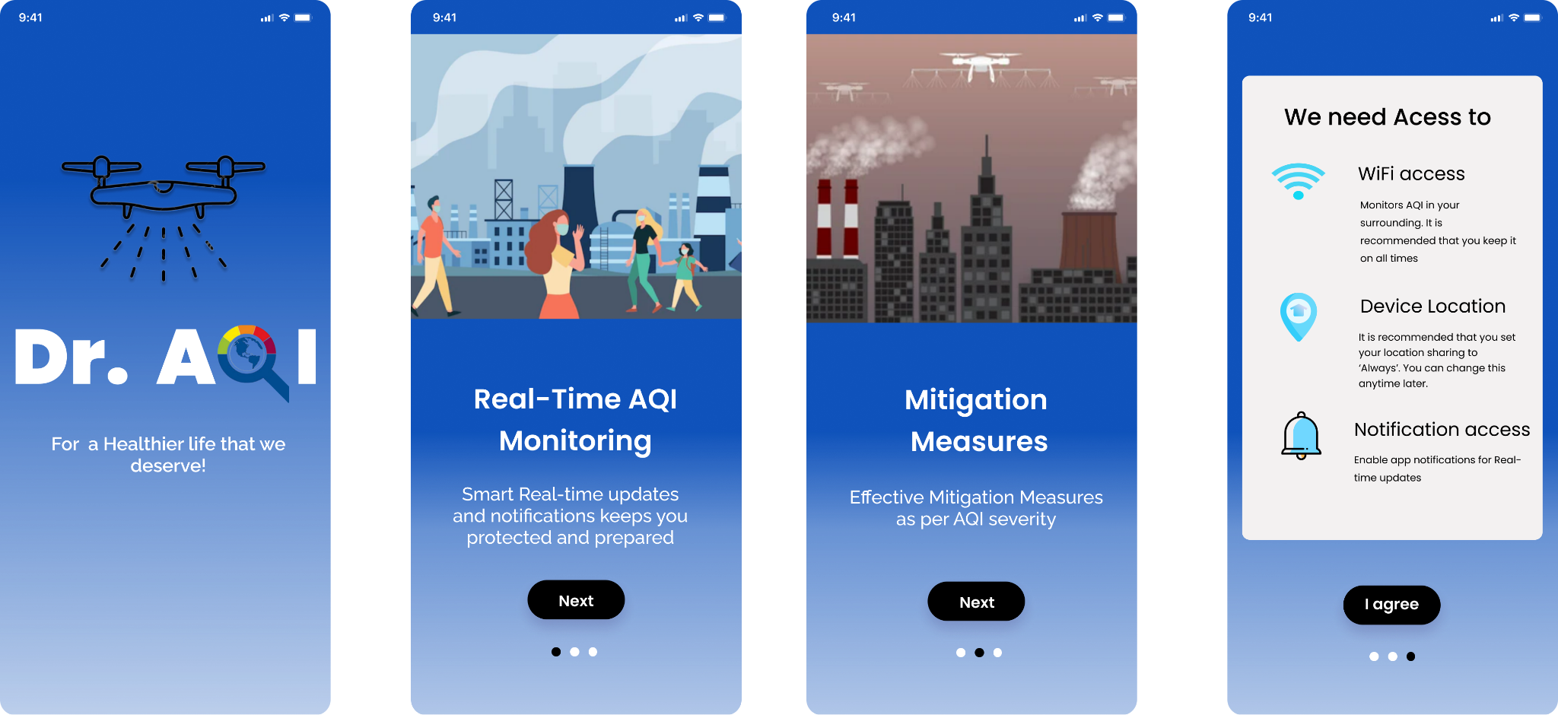

Slide 15
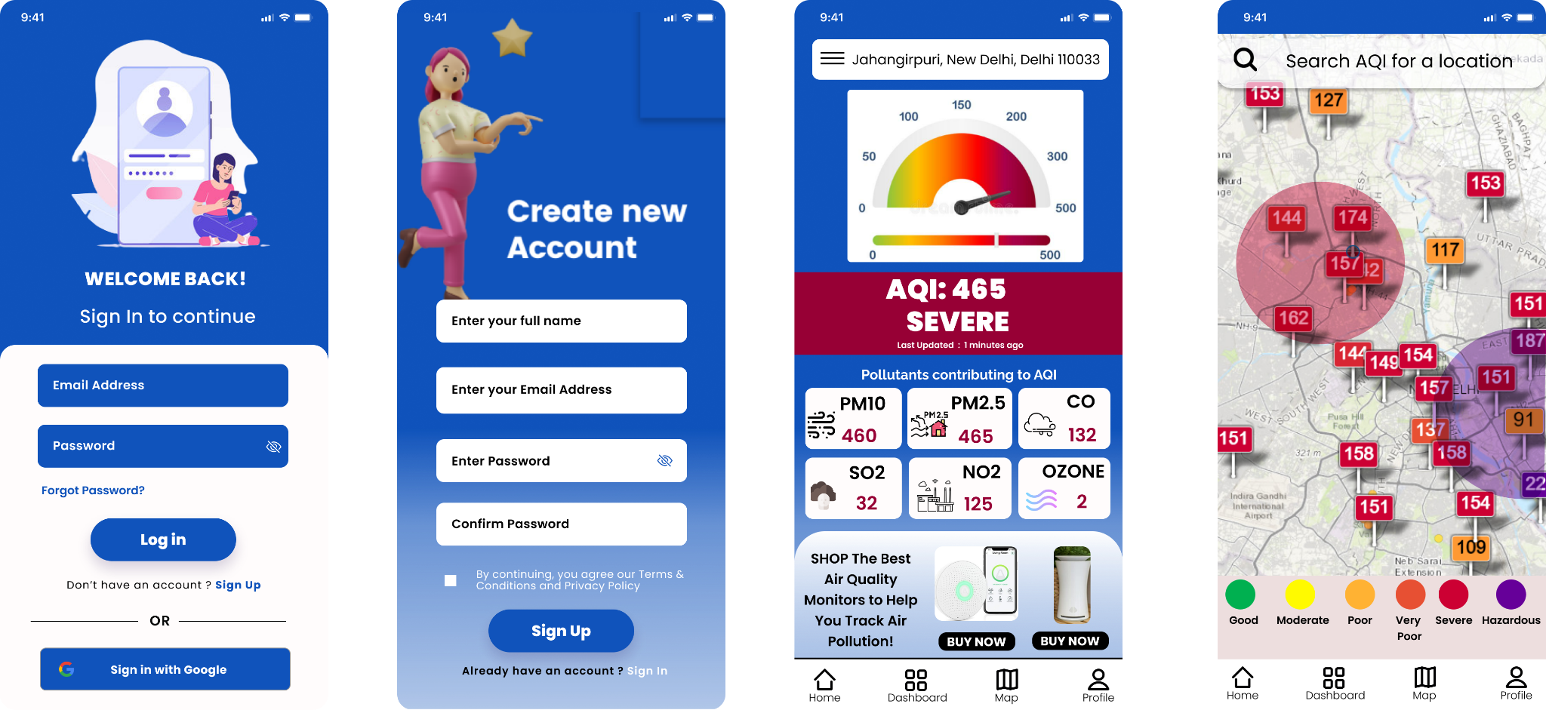

Slide 16
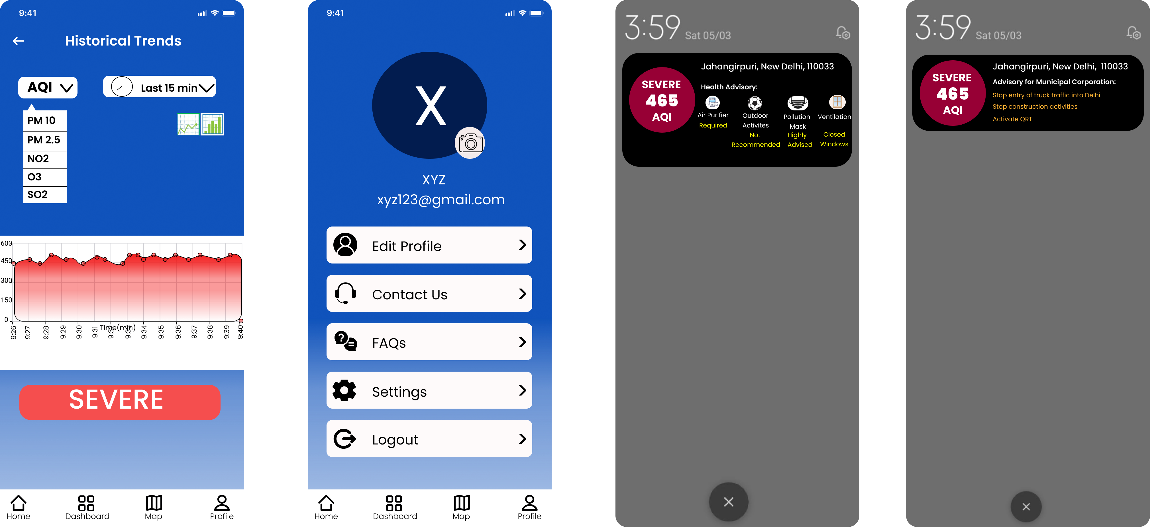

Slide 17
IMPLEMENTATION
05
05

Slide 18
Our Implementation strategy:
STAGE-1:
A. Trial run- Revalidation and customisation
B. Soft launch in tier-2 cities
C. Tie up with Ola/Uber
D. Arrangement of funds
STAGE-2:
Full-fledged Launch in Tier-1 cities followed by Pan-India
Arrangement of funds & Tie-Up with Ola/Uber
Devise Marketing Strategy and Finalizing Subscription Model

Slide 19
TECH STACK USED
06
06

Slide 20








Language: Dart
Frontend: Flutter
Backend:
Firebase which is a Serverless Backend
Database:
Currently using Firestore
Future Scope:
Nodejs, MongoDB, PostgreSQL and AWS Cloud services.

Slide 21
SCALABILITY & FUTURE SCOPE
07
07

Slide 22
SCALABILITY
Highly Scalable with implementation potential Pan-India . Since AQI is worsening all over India, there is a dire need of an app which combines Real-Time AQI monitoring & mitigation measures and caters to combating India’s air pollution.
FUTURE SCOPE & BUSINESS MODEL
Partnership with Ola/Uber and manufacturers of Portable AQI monitors
Collaboration with Pollution Check-up centres & Pollution monitoring stations (both government and private).
Subscription model for Individuals
Advertisement of N95 Masks, AQI monitors and Air purifiers on our app.

Slide 23

THANK YOU! We are open to Questions

